Slide 1


Welcome to the Government Services Union
Onboarding Presentation for New Members

Slide 2



INTRODUCTION
Who am I
Why Onboarding
Why are you here
Notes:
*Introduce yourself, what local you are from
* Explain why we onboard
* Explain what the presentation is about: learning more about your union.

Slide 3


ABOUT YOUR UNION
Both the Public Alliance of Canada (PSAC) and the Government Services Union (GSU) are your union! They just play different roles.
Bargaining => negociate collective agreements
Representation => enforce collective agreements
Mobilization => political campaign, strike
Consultation => local, regional, national level
Education => basic & advance training
Local support => education, membership
Notes:
Explain diff. Between PSAC and GSU. Emphasize on GSU being your Union where you go to if you have work related issues.

Slide 4
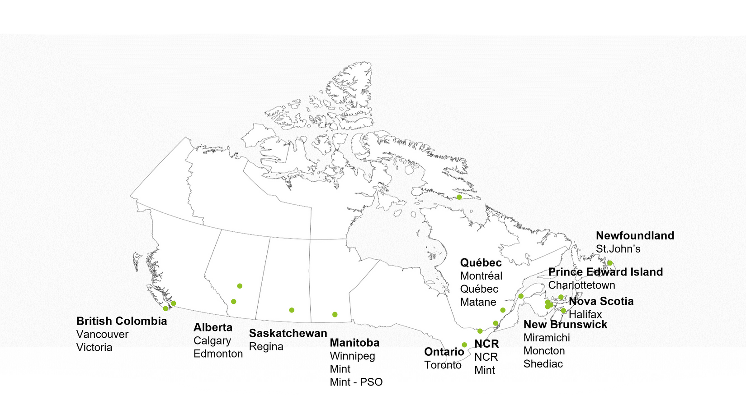
GOVERNMENT SERVICES UNION (GSU)
Created in 1999
Over 12 000 members
24 locals across Canada
3 employers
Public Services and Procurement Canada
Shared Services Canada
Royal Canadian Mint
Notes:
GSU overview

Slide 5
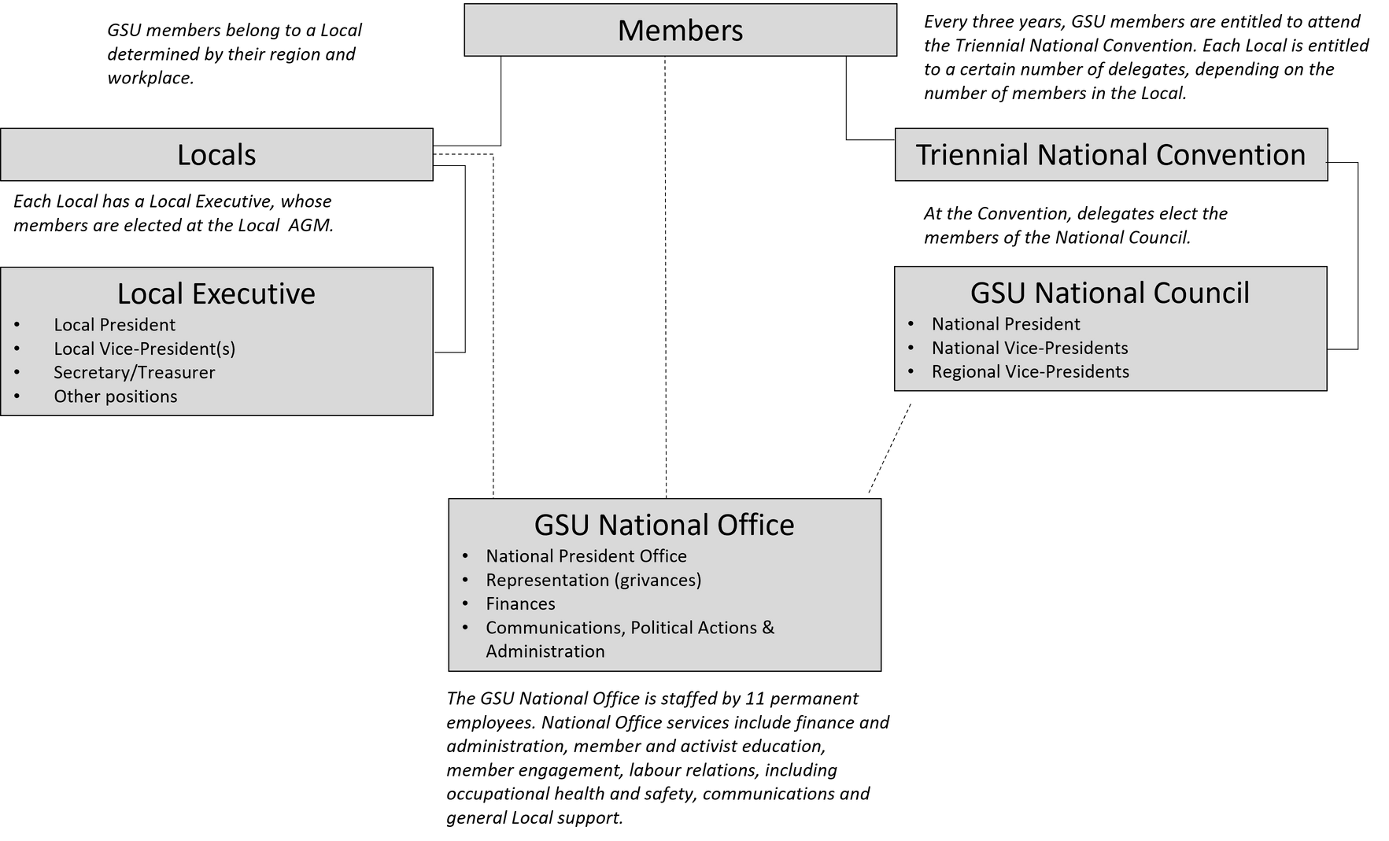
GSU STRUCTURE
GSU’s National Council is elected at our National Triennial Convention by Local delegates and is composed of 15 Regional Vice-Presidents, 3 National Vice-Presidents, (one with the Equity portfolio), and the National President.
GSU’s National Office is located in Ottawa and provides members, Locals, and elected Officers with advice and representation on various labour relations matters including grievances and disability claims, as well as financial and membership services.
Notes:
Focus the member being the core of the union.

Slide 6
Local 70055
Local 70055 represents the PSAC members in the Ottawa/Gatineau region working at Public Services and Procurement Canada (PSPC), and covers the following branches:
Defense and Marine Procurement Branch
Digital Services Branch
Legal Services Branch
Procurement Branch
Departmental Oversight Branch
Integrated Services Branch
The Local carries out three important functions at the worksite. These functions are necessary to create and strong and effective union presence at the worksite.
It provides workplace representation for those workers covered by PSAC collective agreements (including grievance representation and overall membership representation through union-management fora)
It provides political leadership to the members.
It provides direction to the union by ensuring Local concerns and issues are raised.
Your local executive team is voted in by you at the Annual General Meeting held at the end of February/beginning of March. More information about the current executive can be found here: https://gsu-ssg.com/en/locals-1/national-capital/70055-ncr-supply
Notes:
Local Overview

Slide 7
Local Objectives, Authority, and Responsibilities
The Local shall protect, maintain, and advance the interests of the members coming under its jurisdiction.
This Local shall subscribe unconditionally to and accept as its governing documents, the Constitution of the PSAC, the By-laws of the GSU, and the By-Laws of this Local.
This Local shall have the authority to deal with Management representatives in their locality on matters affecting the interests of the membership.
The Local tries to resolve problems that members may have.
The Local will try to have informal consultations first before going the grievance route.
Notes:
Local objectives, authority, and responsibilities

Slide 8
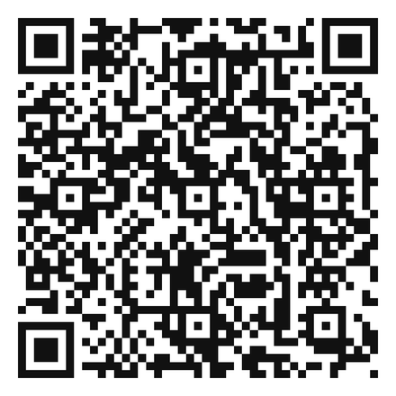
YOUR COLLECTIVE AGREEMENT
Your collective agreement is negotiated between Treasury Board and PSAC. Being a GSU member, you likely belong to one of the three groups:
  Program and Administrative Services (PA)
  Technical Services (TC)
  Operational Services (SV)
What is in a collective agreement?
  Hours of work
  Leave provisions
  Grievance process
  Rates of pay
  and many more protections and benefits.
Note that not all of your working conditions are outlined in the collective agreement
Notes:
Describe QR Code =. GSU CA webpage

Slide 9
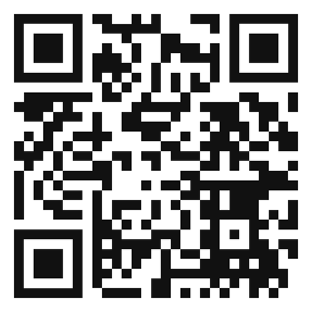
WHEN TO REACH OUT
WHEN IN DOUBT, REACH OUT!
  You feel like you are being harassed or discriminated against.
  You are being denied something you believe you have the right to, based on your collective agreement, such as leave.
  You are asked to attend a disciplinary meeting.
Find your local
Notes:
Emphasize again to reach out to GSU

Slide 10
UNION DUES
0.9617% + $2.20 to PSAC
Union dues - how does it work?
0.615% to GSU
  Every unionized employee pays dues
  Dues are split between PSAC, GSU, and the Local
  Dues are calculated on the first step salary of your classification rather than your actual salary
$ or % to Local

Slide 11
UNION DUES - EXAMPLES
Example 1: Local has a fixed rate of $3.00
Assume you are an AS-01. In 2025, the first step salary for an AS-01 is $61,786.
$61,786 x 1.5767% (PSAC + GSU combined rate) = $974.18 in dues for 12 months.
$974.18 divided by 12 months:
$81.18
+ $ 2.20 for PSAC strike fund
+ $ 3.00 for the Local fixed rate
= $86.38 in dues per month
Example 2: Local has a % rate of 0.235%
Assume you are an AS-01. In 2025, the first step salary for an AS-01 is $61,786.
$61,786 x 1.8117% (PSAC + GSU + Local combined rate) = $1,119.38 in dues for 12 months.
$1,119.38 divided by 12 months:
$93.28
+ $ 2.20 for PSAC strike fund
= $95.48 in dues per month
Notes:
Always calculated on the first step of class

Slide 12
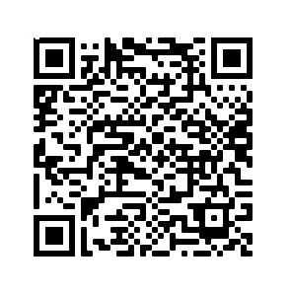
UNION MEMBERSHIP
When you are offered a unionized position, you automatically benefit from the conditions outlined in your collective agreement.
You are what is called a RAND member.
Why sign the card ?
  Union training
  Union events
  Ability to vote (strike, local elections)
  Strike pay
  Run for an elected position
To formally become a member of the PSAC and GSU and access all union benefits, you must sign your membership card. You will then become a member in good standing.
DON‘T WAIT - SIGN YOUR CARD NOW
Regardless of your status, you pay dues!
Notes:
Rand do pay dues! QR Code: Electronic form

Slide 13



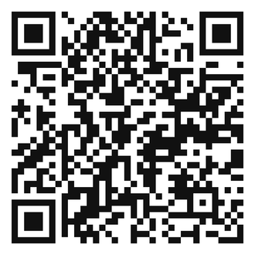
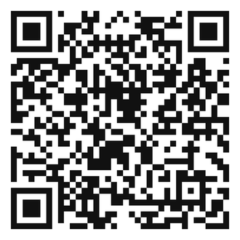
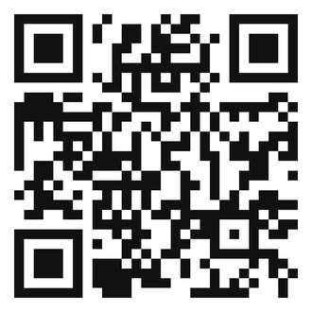
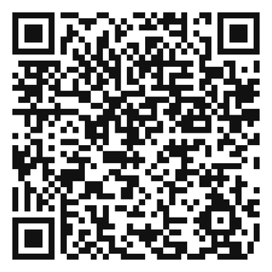
MEMBERS BENEFITS
and many more....
$10 000 Group Life Insurance with Coughlin
Union Savings Program
(discounts on various products)
GSU Bursaries for dependants and members
Notes:
PSAC also has bursaries

Slide 14
HOW TO GET INVOLVED
LEARN ABOUT YOUR UNION AND WHO YOUR LOCAL REPRESENTATIVES ARE
ATTEND YOUR LOCAL ANNUAL GENERAL MEETING (AGM)
HELP YOUR LOCAL
This is the starting point – learning
about GSU and getting to know
your Local representatives will help you better understand how
everything works!
Attending your Local AGM
is a great way to learn more about the business of your Local. This is when you will vote on your Local’s budget and run for an elected position.
Locals are always looking for help in the field, whether to share information, mobilize members, organize social events, or meet new members.
Notes:
There's space for eveyrone to help out.
Part of the CA = it is your right to participate in union activities

Slide 15
CONTACT
Don’t hesitate to reach us!
Local 70055
Web page: 70055 NCR Supply :: Government Services Union
Facebook: GSU Local 70055 Section locale 70055 SSG

Slide 16

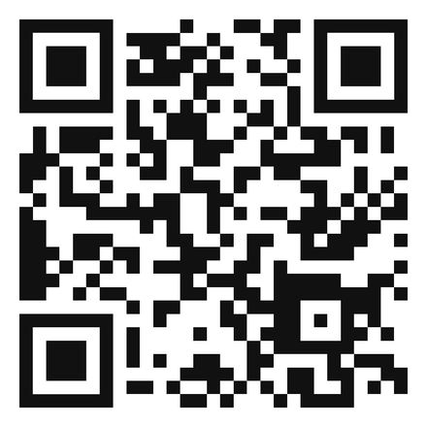
RESOURCES
Government Services Union
Public Service Alliance of Canada
Notes:
Add in any local specific ressources (eg. Facebook page)

Slide 17
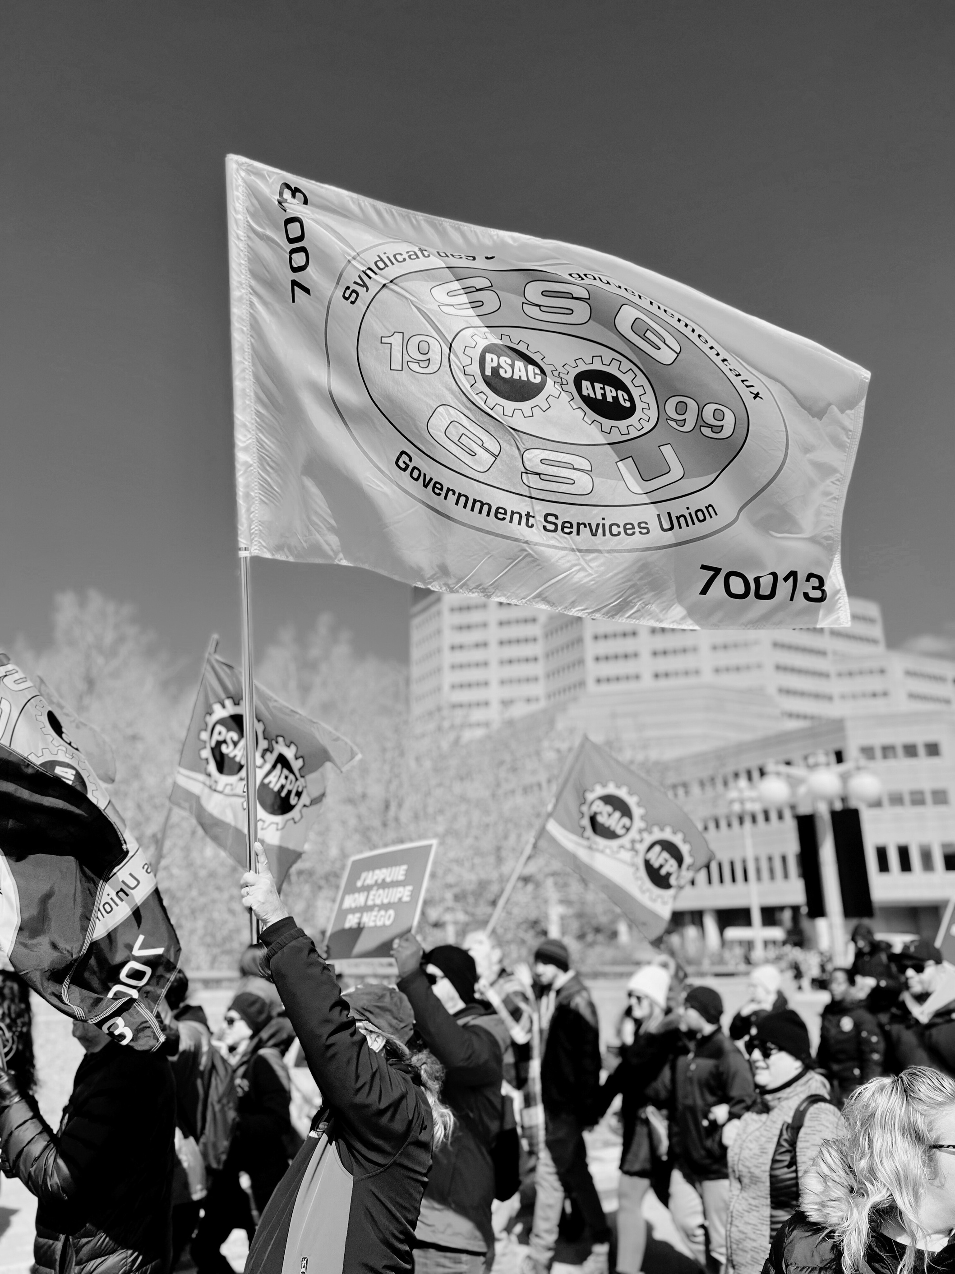
Questions
Reach out to your local representatives: general.inquiries.local70055@gsu-ssg.com
Notes:
Don't know the answer? It's ok ! Get back to the person later and take it as an engagement opportunity

